Slide 1





Chicago's Culinary Compliance A review of restaurant and food service inspections
Vikranth
Chapaala
Phanindra Anagam
Ritesh Vesalapu

Slide 2
Literature Review
Relationship of Restaurant dining with incidence of food-borne diseases
Effects of Inspections on Food safety of Restaurants

Slide 3
Agenda
Objective
Data
EDA
Modelling
Conclusions

Slide 4

Objective
To explore the relationship between the attributes of food establishments and the outcomes of their inspections
Key focus areas include:
Examine trends and patterns in pass/fail rates over time
Assess the impact of different inspection types on these rates
Analyze common violations for targeted safety improvements
Develop a predictive model to forecast future inspection outcomes

Slide 5

Data Description
(Unique)
Risk
Inspection ID
Inspection Type
Facility Type
Results
Violations

Slide 6





Data Cleaning and Libraries used
Missing Values Handling
Used BeautifulSoup4 to scrape suburbs from Chicago
Ensured Data Consistency using fuzzywuzzy
Extracted Violation codes using regular expressions with re library
Used folium for Geospatial mapping

Slide 7
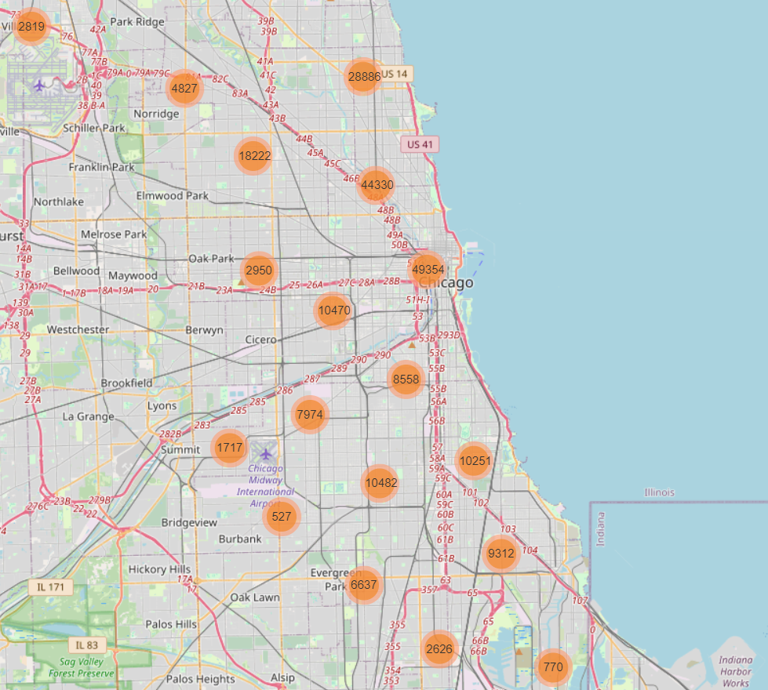
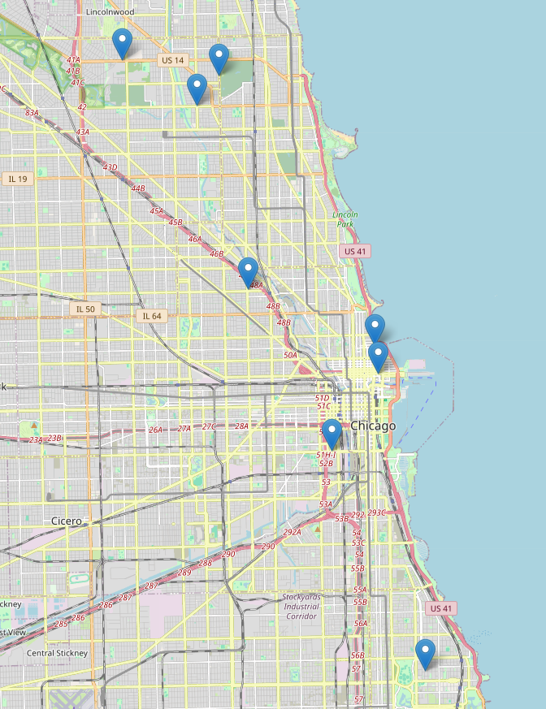
Geospatial Mapping

Slide 8
Exploratory Data Analysis
Overview
Risk
Facility
Inspection
Restaurants
Violations

Slide 9
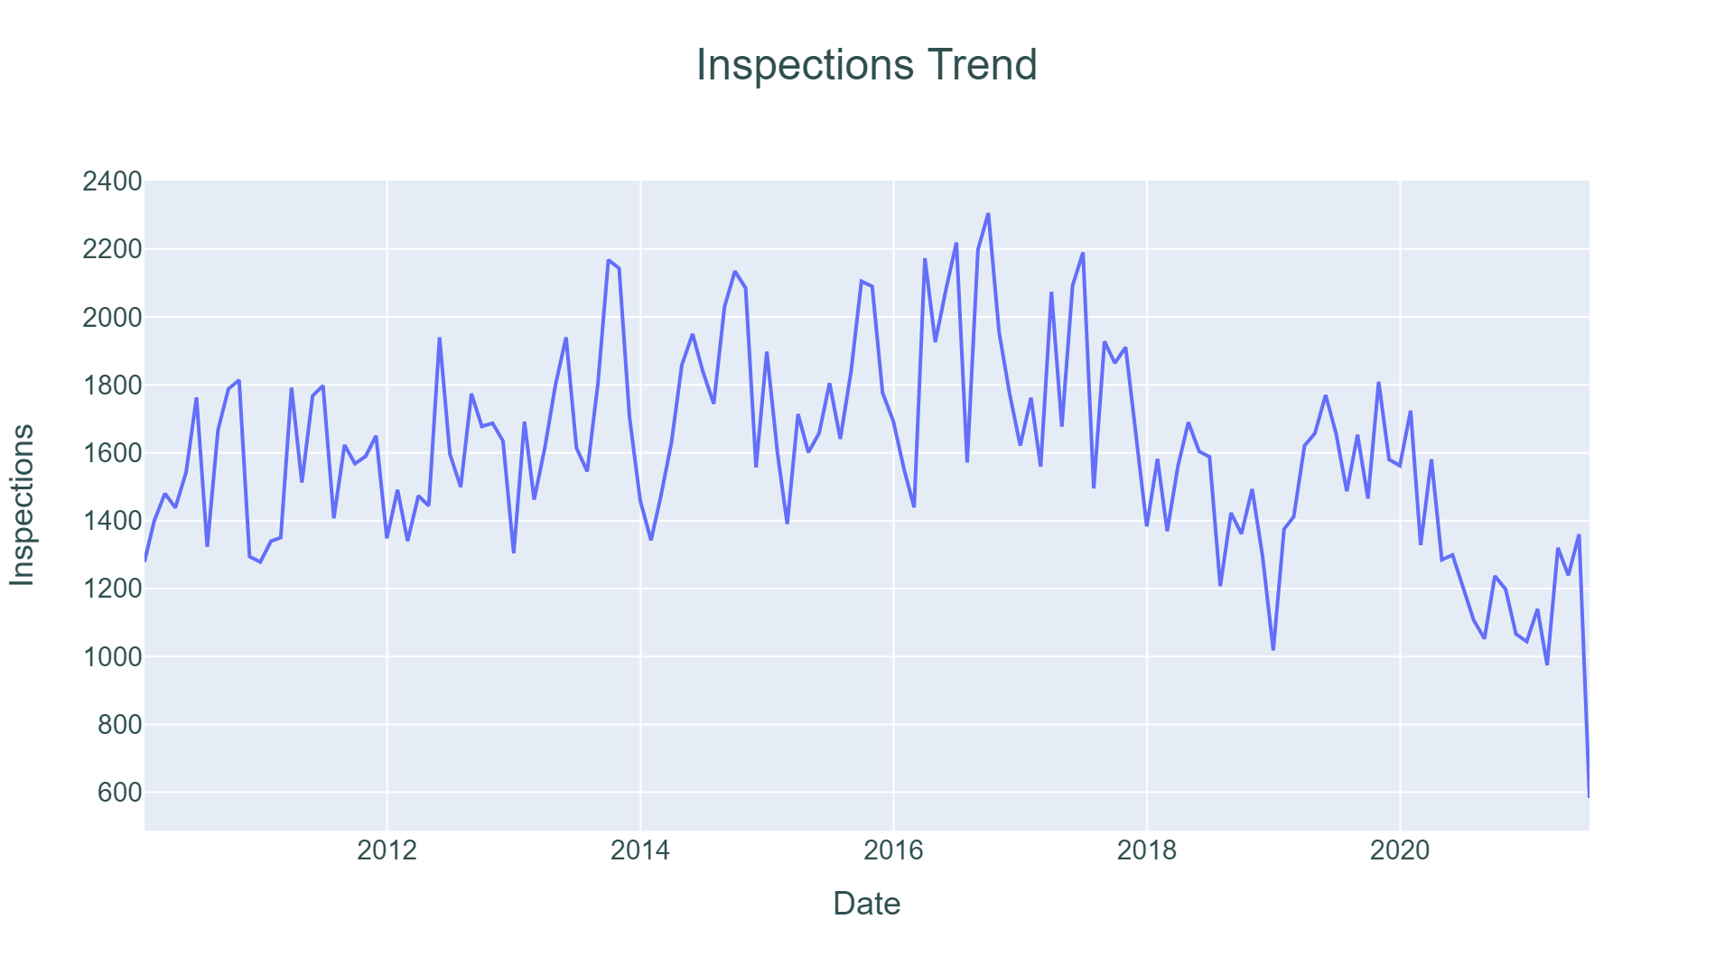
Overview
30k
Establishments
12 Years
Timeframe
221k
Inspections
220k
Location Data

Slide 10
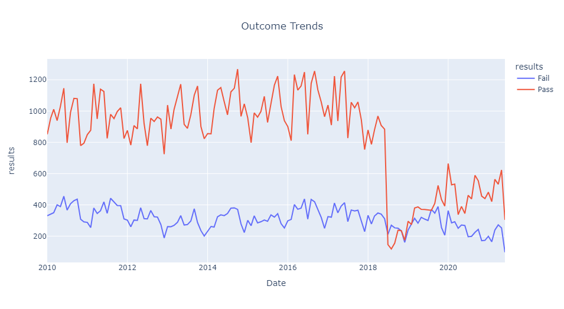
Outcome trends

Slide 11
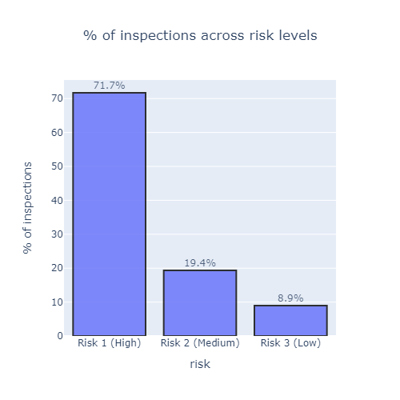
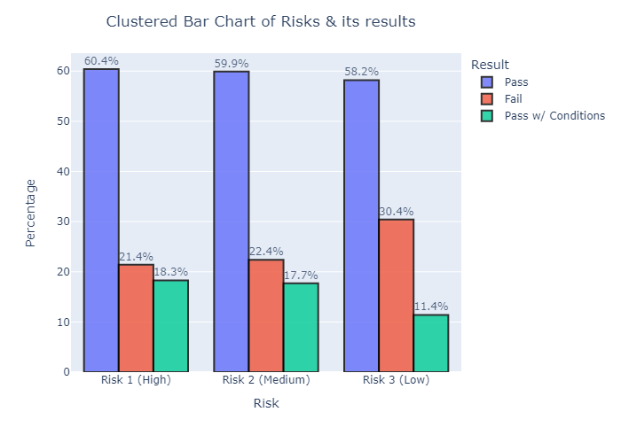
Risk Analysis

Slide 12
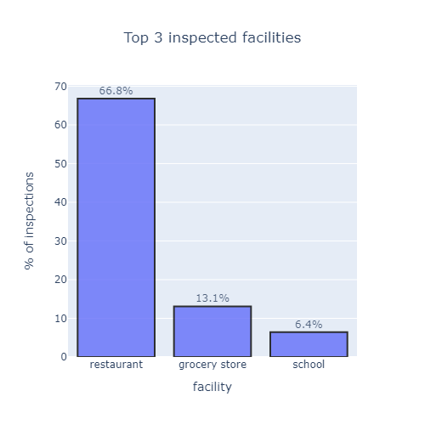
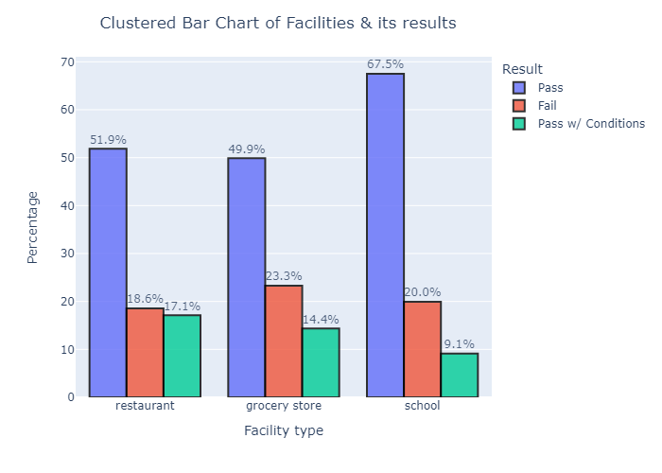
Analysis of Facility Types

Slide 13
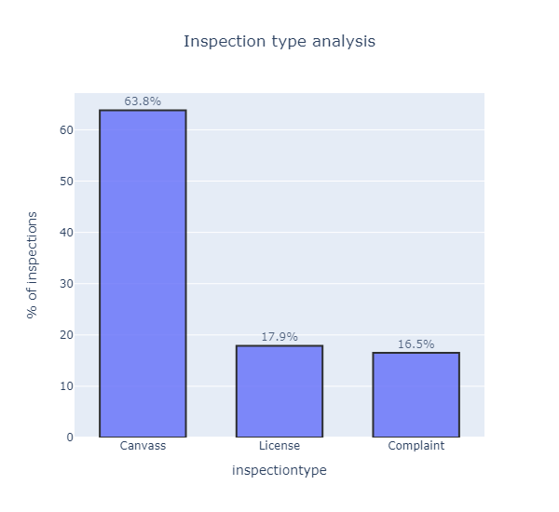
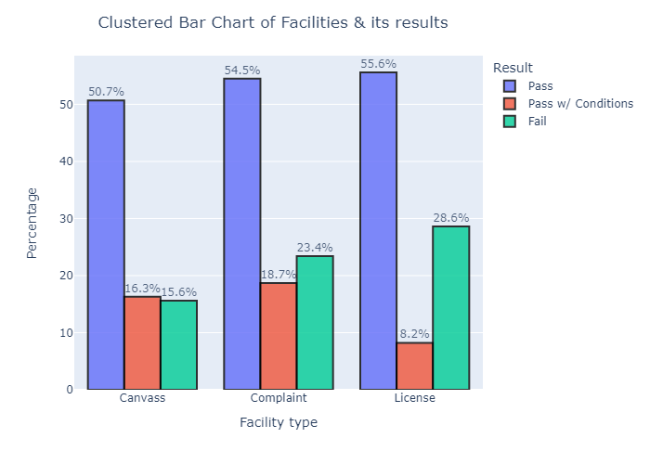
Analysis of Inspection Types

Slide 14
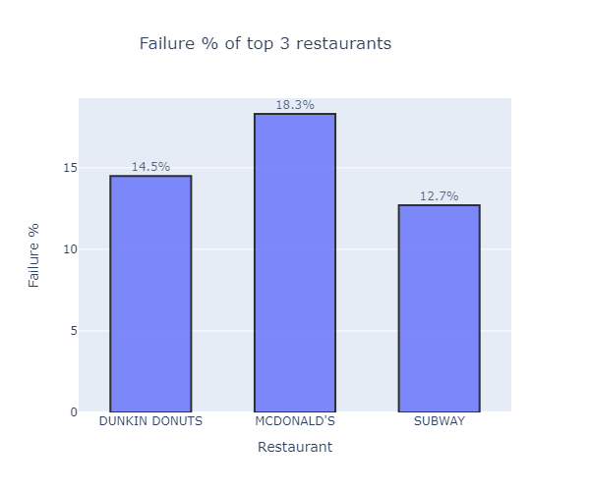
Analysis of Restaurants
In every 100 restaurants inspected, there are at least 2 inspections at Subway and 1 inspection at Dunkin Donuts.

Slide 15
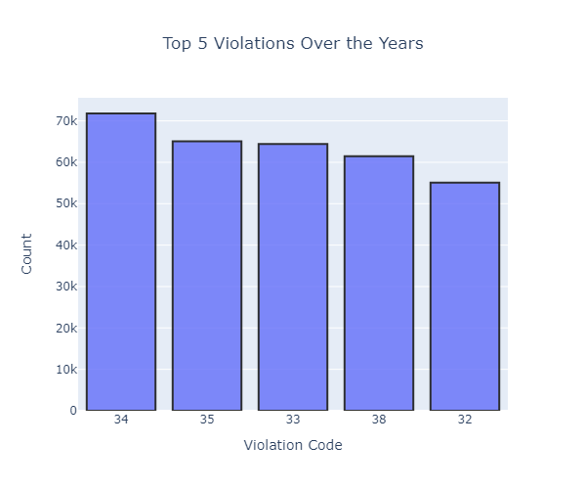
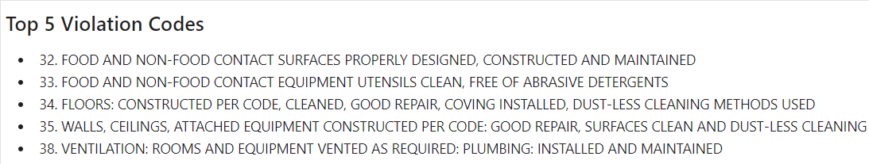
Analysis of Violations
45 Violation codes
Most Reported Violation: Code 34
Out of 160k inspections with violations, ~20k citations were observed.

Slide 16
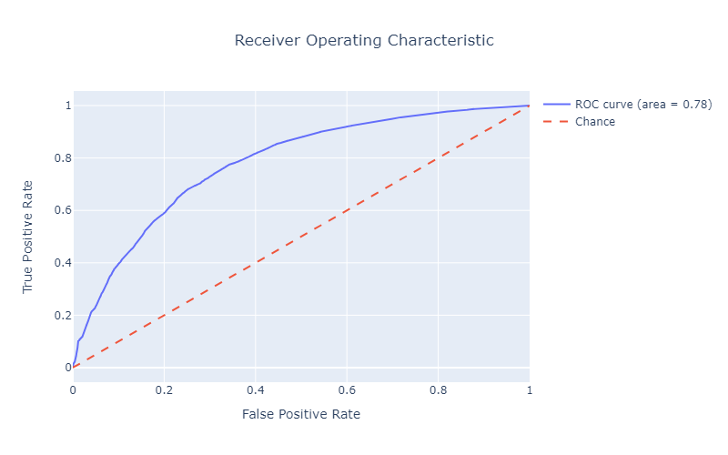
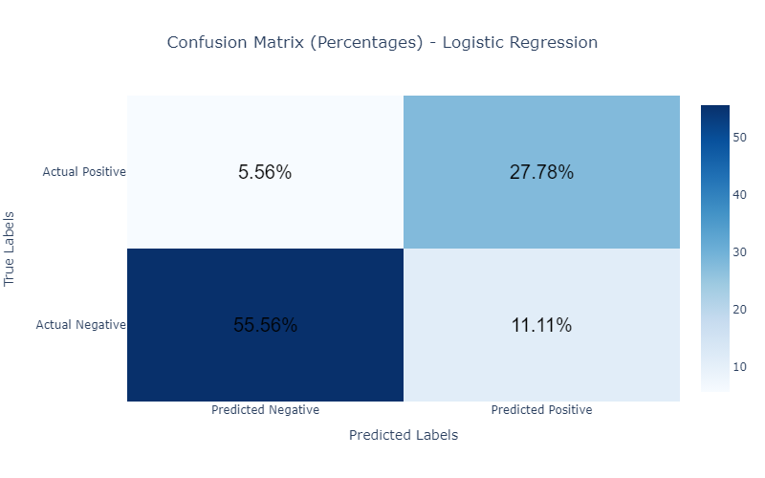
Modelling
Model | Accuracy
Logistic Regression | 74%
Decision Tree | 71%
Random Forest | 73%

Slide 17
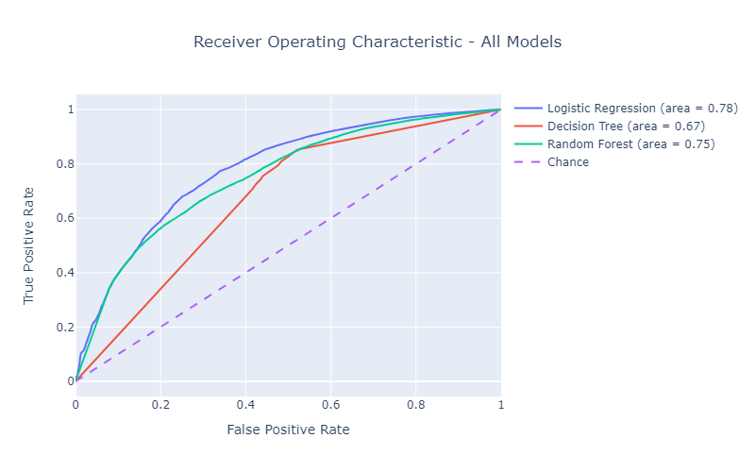
Model Comparison
Models are ranked by their ability to correctly classify observations
Logistic Regression (AUC: 0.78) outperforms Random Forest (AUC: 0.75) and Decision Tree (AUC: 0.67)

Slide 18
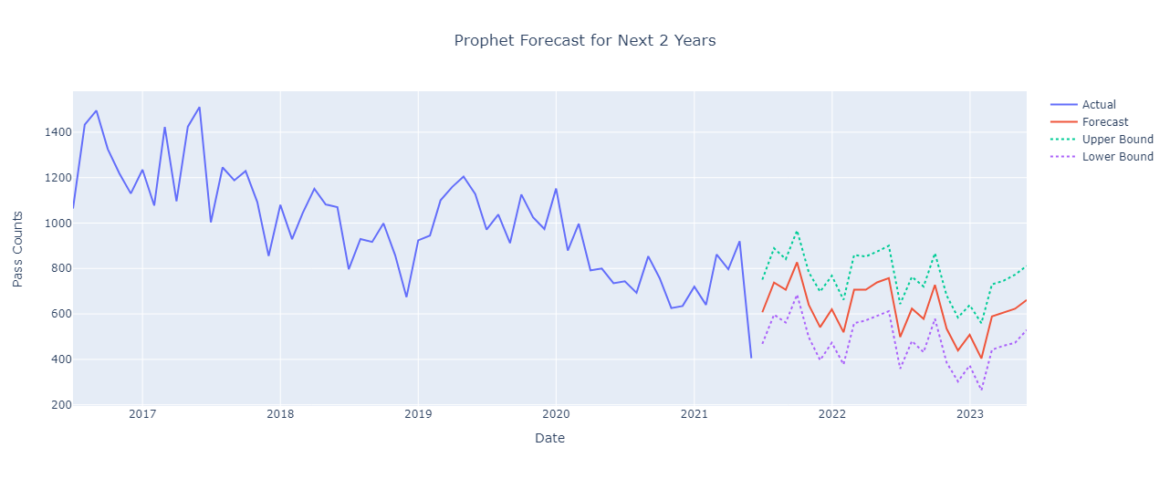
Forecasting Pass

Slide 19
Conclusions
The number of violations, citations an inspection received, and the inspection type seem to be affecting the inspection outcome.
Hypothesis: The attributes of food establishments impact the outcomes of their inspections - True

